Slide 1
What is plant ecophysiology?
Jan 22, 2019

Slide 2
Ecophysiology = Ecology + Physiology

Slide 3
Ecology: definition
The study of the relationships between organisms and:
Each other
The environment

Slide 4
Ecology: definition
The study of the relationships between organisms and:
Abiotic environment
Biotic environment

Slide 5
What aspects of the abiotic and biotic environment influence plant functioning?
Notes:
Take a few minutes to discuss

Slide 6
Hierarchy of Ecology
Ecosystem Ecology

Slide 7
Hierarchy of Ecology
Community Ecology
Ecosystem Ecology

Slide 8
Hierarchy of Ecology
Population Ecology
Community Ecology
Ecosystem Ecology

Slide 9
Hierarchy of Ecology
Physio-logical Ecology
Population Ecology
Community Ecology
Ecosystem Ecology

Slide 10
Physiology: a definition
The functioning of an organism that allows it to survive, grow, and reproduce

Slide 11
Ecophysiology: a definition
Responses to environmental conditions observable at the individual level
https://gfycat.com/webbedopulentarrowana

Slide 12
Ecophys discussion: traits

Slide 13
Discussion
What is a plant trait?
How do plants get their traits?

Slide 14
Discussion
What is the difference between acclimation and adaptation?
How would you know?

Slide 15
Why do we care about plants and their traits? Discussion of Chapin (2003)

Slide 16
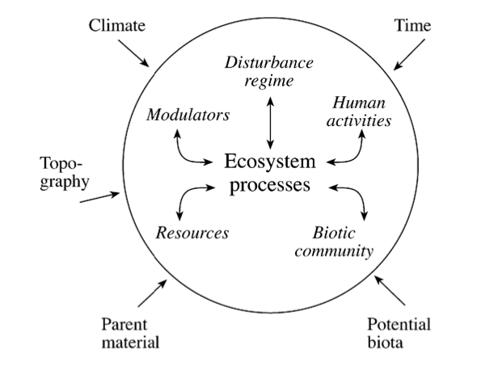
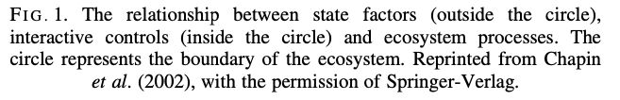

Slide 17
Ecosystem Service
Image from Fermi Natl. Lab

Slide 18
Global changes to state factors
Changes in atmospheric gas concentration (e.g., elevated CO₂)
Warming temperatures
Altered precipitation patterns
Nutrient deposition
IPCC (2013)

Slide 19
Plants as interactive controls
Biodiversity
Disturbance regulators (e.g., fire)
Movers of resources
Modulators (e.g., albedo, microclimate)
Interaction with humans (e.g., agriculture)

Slide 20
To understand how ecosystem services will change in the future, we need to understand plants

